Slide 1



INTRODUCING:
AN INTERACTIVE ANALYSIS
OF MIAMI’S HOUSING MARKET
In a world where downtime is more wishful thinking than reality, it’s essential that your home offers true tranquility, space, and comfort.​

Slide 2

?Who doesn't dream of the perfect home?
But what if you could unlock the secrets of the
real estate market before investing?
Would knowing the inside track help you secure not just any property, but your dream property

Slide 3


INTRODUCTION:
1.
OUR PURPOSE
Explore the impact of property features and location on sale prices in the Miami housing market.
2.
Data Overview:
Analysis based on specific features of 13,932 properties sold in 2016, including structure quality, proximity to points of interest, and special features.​
​
3.
Our Contributors:
Karen Batista
Grace Martinez
Rene Mazuela
Alicia Ramos Perez
02

Slide 4



INSIGHTS
1.
Average Sale Price by Structure Quality: Indicates how higher quality properties generally command higher prices.
2.
Correlation Between Sale Price and Special Features (gardens, pools, garages, etc.): Highlight the moderate correlation and its implications for property valuation.
3.
Relationship between sale price and distances to points of interest: To determine price average.
4.
Imagine a space that goes beyond the traditional. A space that grows with your goals. A place that empowers. A partner in your vision.
03

Slide 5
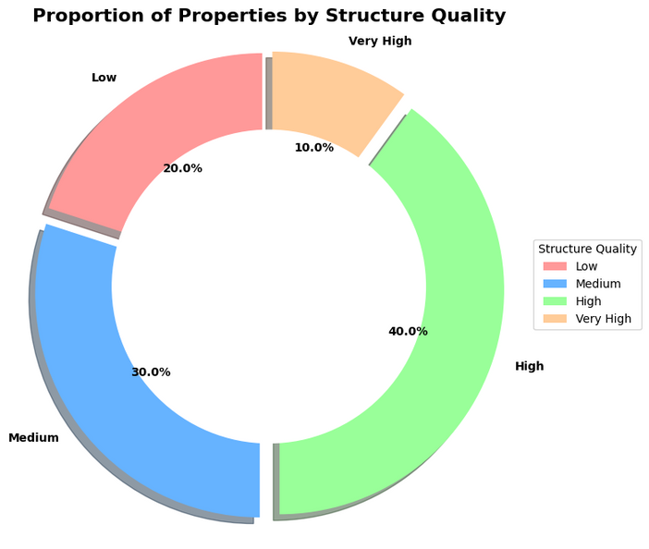
Implications for Pricing, Marketing, and Quality Categories
Potential buyers or investors can deduce that the market has a high concentration of good quality properties, while top-notch and low-end quality homes are less common This could end up affecting pricing strategies and marketing focus for real estate professionals. This also provides insights into property availability across various quality categories.
05

Slide 6
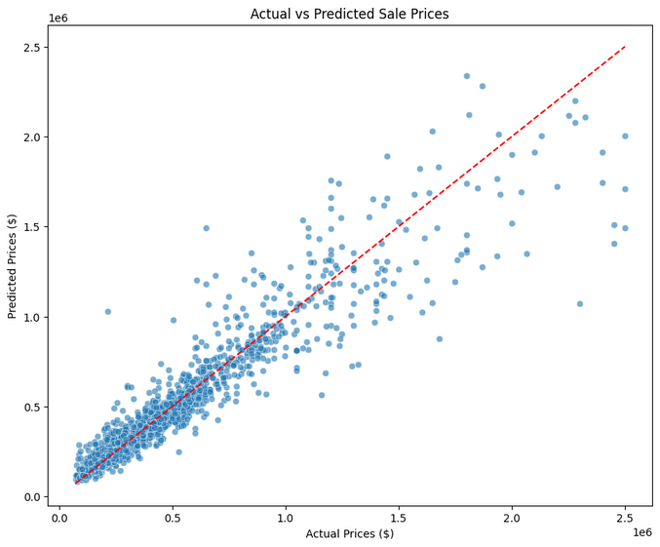
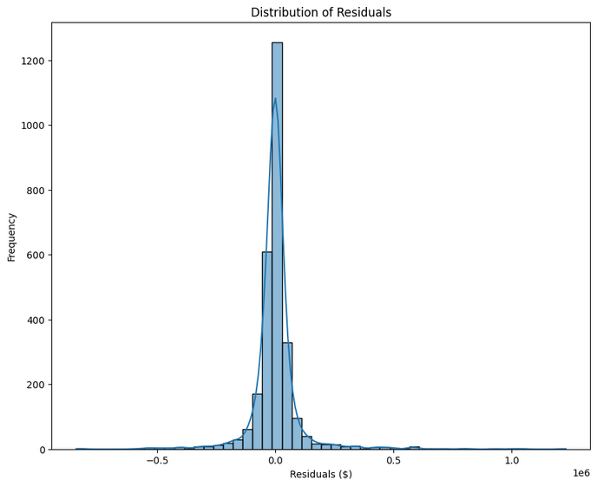
Model Pipeline Results
These two key visualizations commonly used in evaluating predictive models:
Scatter Plot:
This plot compares predicted prices against actual prices.
A perfect model would have all points falling exactly on a dashed red line, indicating perfect alignment between predictions and actual values
Histogram of Residuals:
Residuals are the differences between predicted and actual values.
The histogram displays the distribution of these residuals.
It helps in identifying any bias in predictions and understanding how errors are distributed across the dataset.
05

Slide 7

Limitations Occurred
1.
Price Appreciation Rates:
Cannot be calculated without historical data across multiple years.
Inventory Levels: Can't be assessed without data on current listings or sales over different time periods.
2.
Cost-Benefit Analysis:
Challenging without explicit cost data for properties and future appreciation projections.
3.
User Feedback and Market Research:
Requires additional survey data or market reports.
06

Slide 8

THANK YOU!
06

